Slide 1




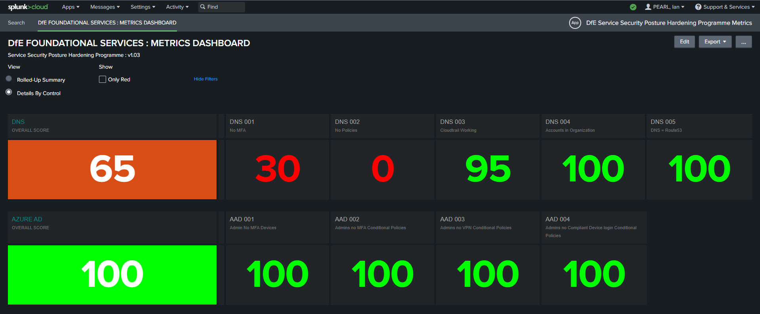
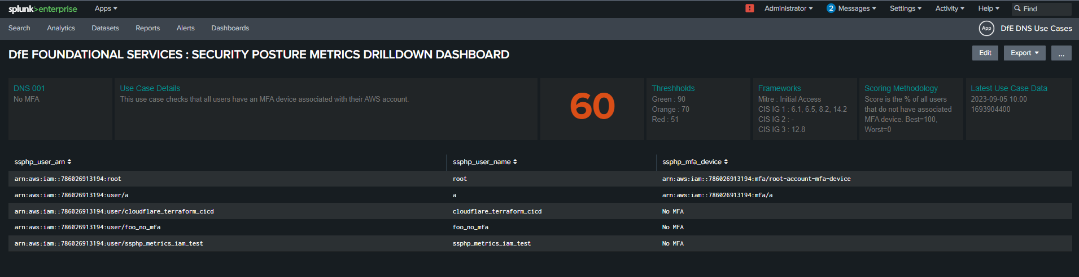
SSPHP
DEPLOY PIPELINE
GitHub
AWS DNS
AZURE AD
SDK
SDK
package.py
AZURE FUNCTION
HEC
Victoria
Experience
USE CASES
SAVED SEARCH
MACRO
Terraform
SSPHP NOTABLE INDEX
GitHub Actions
ROLLUP SCORE USE CASES
MACRO
SAVED SEARCH
PR
METRICS DASHBOARD
GitHub
DEPLOY PIPELINE
DRILLDOWN DASHBOARD

